Slide 1
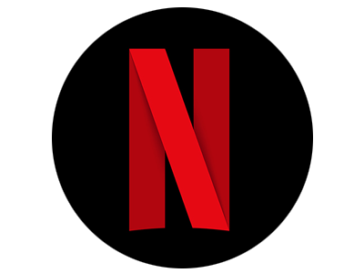
Data Analysis for Netflix Original Content Department
Paul Kilgarriff

Slide 2
Datasets
Rotten Tomatoes
17400 Films
Audience Data
Critic Reviews
Production Cost
Box Office Take
Netflix
6100 Films
Categorisation
Release Date
Date Added to Catalogue
Production Cost
Viewing Figures
Subscriber Count/Retention
Count Audience Ratings Used as Proxy for Viewing Figures

Slide 3
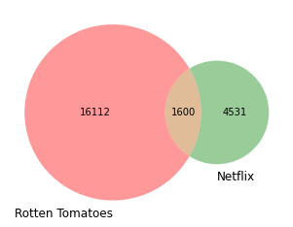
Datasets
Notes:
Netflix Only: 4531
Netflix and on Rotten Tomatoes: 1600
Netflix Total: 6131
Not on Netflix: 16112

Slide 4
Key Insights
Runtime - Is there an impact on Audience Rating?
Where are the current gaps in the Netflix Catalogue?
Judging a Script by its cover

Slide 5
Does Runtime Affect Audience Rating?
Notes:
Reminder that only 1600 ~10% of Rotten Tomatoes Catalogue is available on Netflix
What is missing?

Slide 6
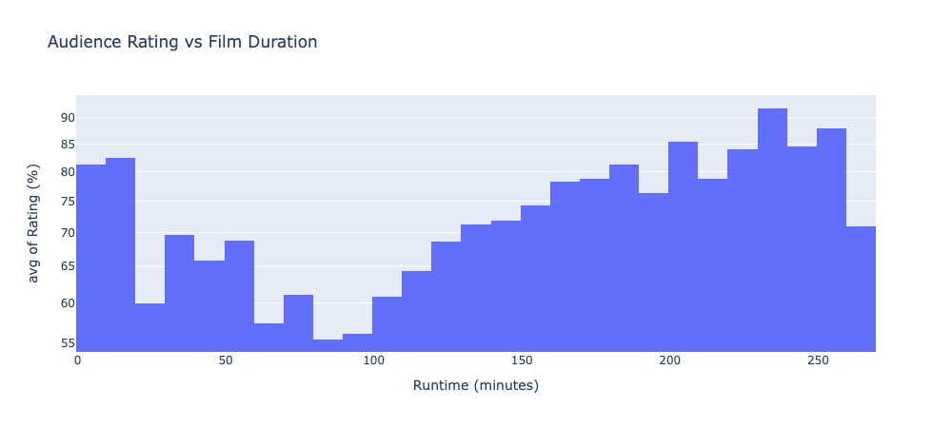

Slide 7
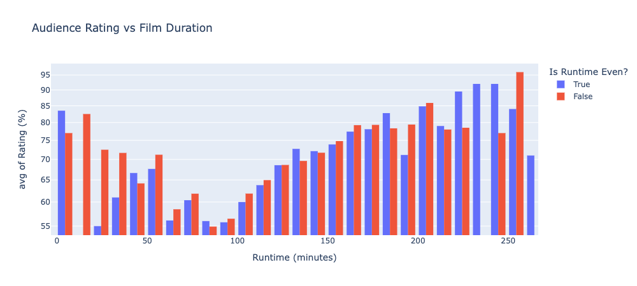
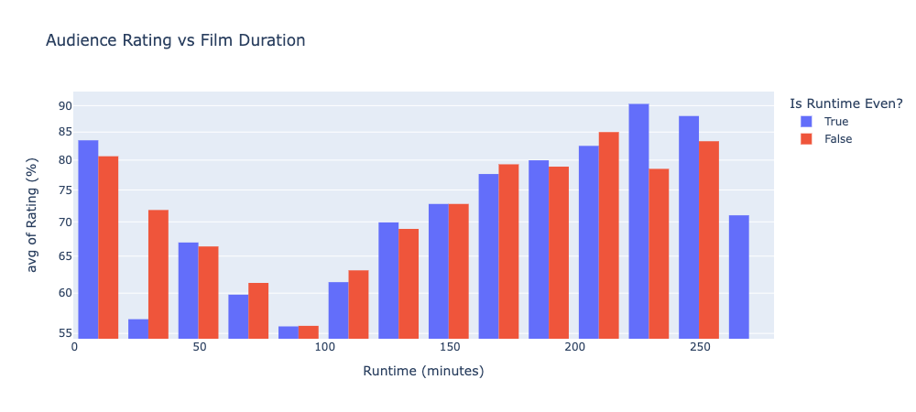

Slide 8
What is missing from Netflix?
Notes:
Reminder that only 1600 ~10% of Rotten Tomatoes Catalogue is available on Netflix
What is missing?

Slide 9
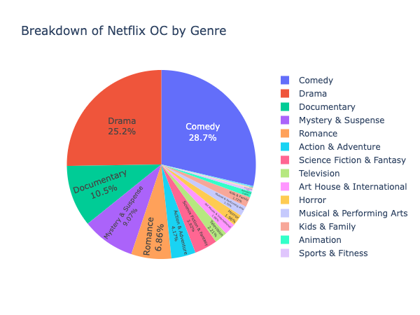

Slide 10
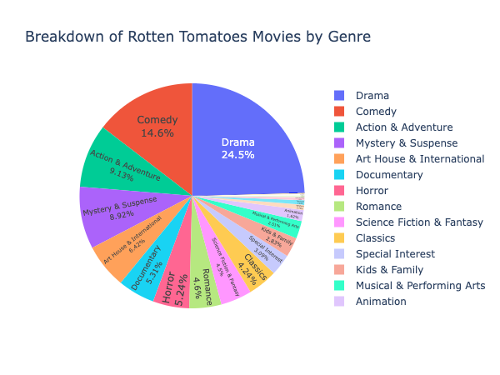

Slide 11
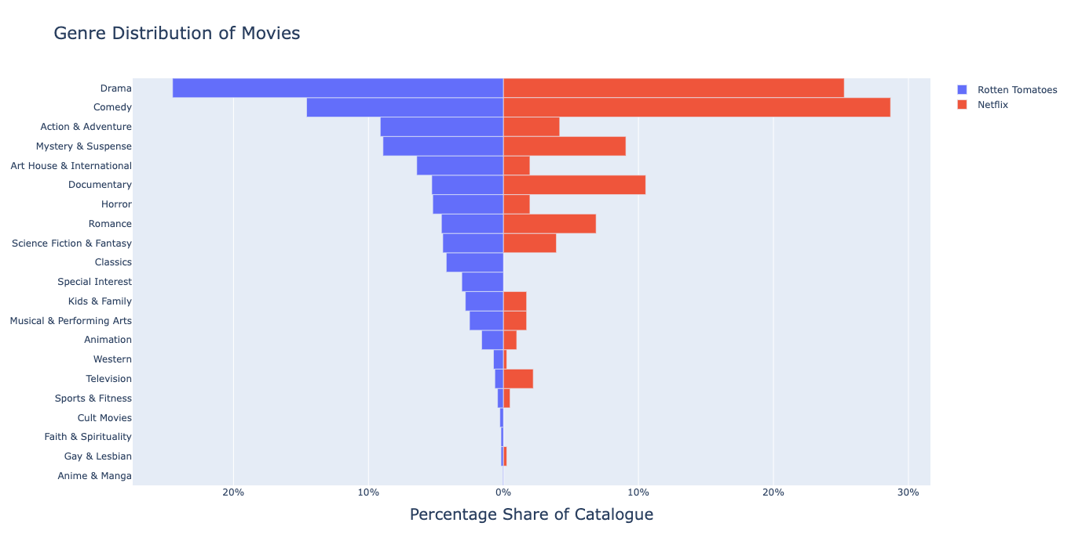

Slide 12
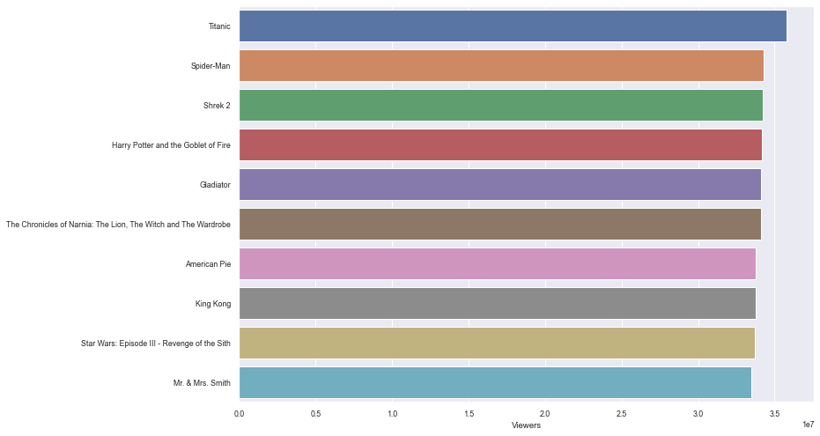
Notes:
Here are your “easy wins” - interestingly only two original standalone movies here (Titanic & Gladiator)
Everything else is either a remake or part of a franchise
Designate enough of the budget to acquire some of these
Further information on the top 50 and 100 available on request

Slide 13
Key Words to Include and Avoid
Notes:
Reminder that only 1600 ~10% of Rotten Tomatoes Catalogue is available on Netflix
What is missing?

Slide 14
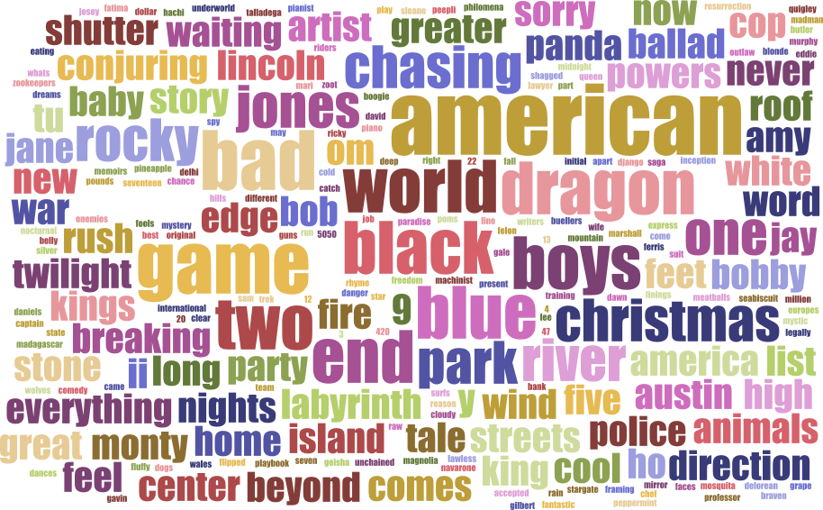
Good Films (>70% rating)

Slide 15
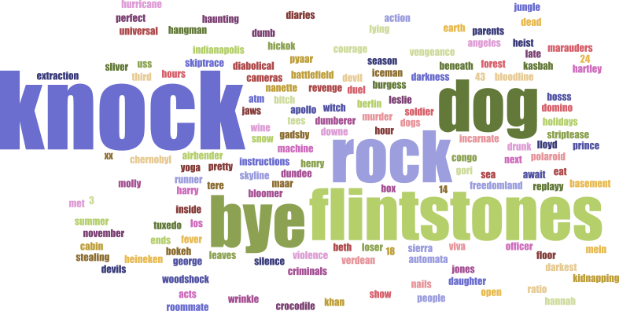
Bad Films (<30% rating)

Slide 16
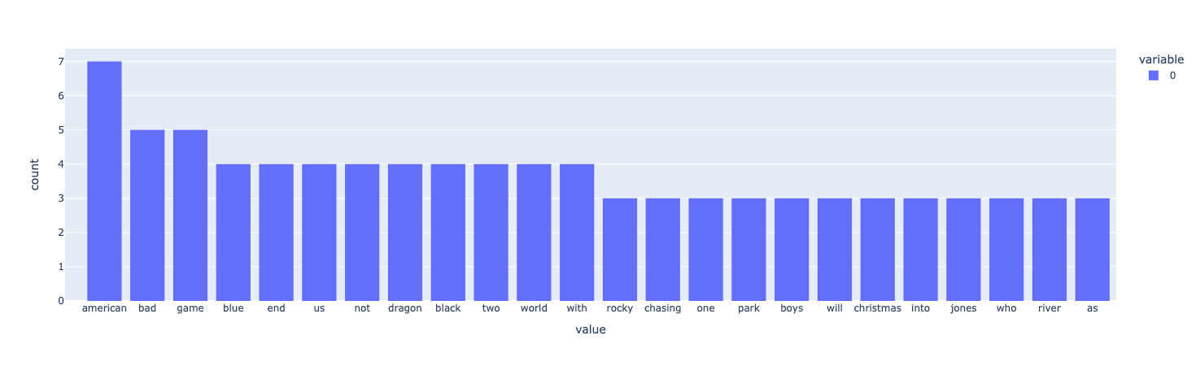
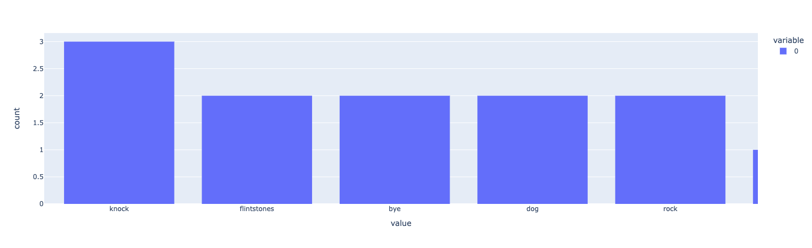
Good Films (>70% rating)
Bad Films (<30% rating)

Slide 17
Films Containing Uniquely Good Words
American Hangman
Game Over
Man!
A Bad Moms Christmas
American Assassin
American Ultra
Bad Boys II
American Psycho
Miss Americana
El Camino: A Breaking Bad Movie
American Factory
Gerald’s Game
American Honey
Superbad
American Outlaws
End Game
Bad Day for the Cut
The Short Game
The American
Bon Cop, Bad Cop

Slide 18

Take-Home Messages
Data Insights
Avoid the 90 minute lull
Move the focus away from Comedy
Don’t make a film called Knock the Last Dog
Do make a film called Love, Life, and the American Game
Sequels might be a safer bet - but avoid oversaturation
Next Steps
Provide a further data set so these insights can assessed against subscriber numbers
Production Cost would allow for a more quantitative analysis of benefit to the Company
github.com/PKilgarriff/netflix-analysis
Notes:
Split the audience and cater to those who prefer shorter films and to those who prefer longer films
There are clear gaps in the current catalogue, suggested films to cover these are available.

